Slide 1
Unit 1 Introduction of CG (LH 2)

Slide 2
Hardware
Input Devices:
Input device are used to feed data or information into a computer system.
They are usually used to provide input to the computer upon which reaction, outputs are generated.
Data input devices like keyboards are used to provide additional data to the computers whereas
pointing and selection devices like mouse, light pens, touch panels are used to provide visual and indication-
input to the application.

Slide 3
1. Mouse
A mouse is a small hand-held device used to position the cursor on the screen.
Mouse are relative devices, that is, they can be picked up, moved in space, and then put down gain without any change in the reported position.
For this, the computer maintains the current mouse position, which is incremented or decremented by the mouse movements.

Slide 4
2. Keyboard
A keyboard creates a code such as ASCII uniquely corresponding to a pressed key.
It usually consists of alphanumeric keys, function keys, cursor-control keys, and separate numeric pad.
It is used to move the cursor, to select he menu item, pre-defined functions.
In computer graphics keyboard is mainly used for entering screen coordinates and text, to invoke certain functions.

Slide 5
Digitizers: A digitizer is a locator device use for drawing, painting or interactively selecting coordinate positions of an object. Graphics tablet is one such digitizer that consists of flat surface. The size may range from about size 6”x6” and 48”x78”. It can detect the position of a movable stylus.
4. . Touchpad: Touchpad is a stationary pointing device that many people find less tiring to use than a mouse. The movement of a finger across a small touch sensitive surface is translated into pointer movement on screen. The touch sensitive surface may be only 1.5” or 2” square screen.

Slide 6
5. Light pen
It is a pencil-shaped device to determine the coordinates of a point on the screen where it is activated such as pressing the button.
In raster display, Y is set at Ymax and X changes from 0 to
Xmax for the first scanning line.
For second line, Y decreases by one and X again changes from 0 to Xmax, and so on.
When the activated light pen "sees" a burst of light at certain position as the electron beam hits the phosphor coating at that position,
It generates a electric pulse, which is used to save the video controller's X and Y registers and interrupt the computer.

Slide 7
6. Data Gloves
Data glove is an interface device that uses position tracking sensors. The movement of the hand and figure are displayed live on the computer. It allows the user to virtually touch an object displayed on the monitor. By wearing data gloves user can pick up an object and do things just as he/she could do with real object.

Slide 8
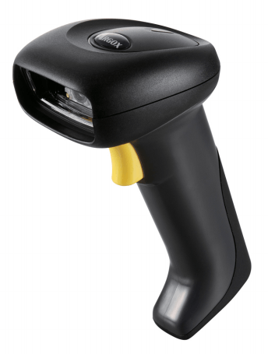
7. Bar Code Reader
The purpose of a barcode scanner is to scan or read a barcode symbol and then provide an electrical output to a computer via a decoder and cable. The decoder recognizes the type of barcode symbology it is seeing, translates the bar and space content and transmits data to a computer in a human readable format.

Slide 9
Video Display Devices
The display devices are also known as output devices the most commonly used output device in a graphic system is a video monitor. The operation of most video monitor is based on CRT (Cathode Ray Tube) design.

Slide 10
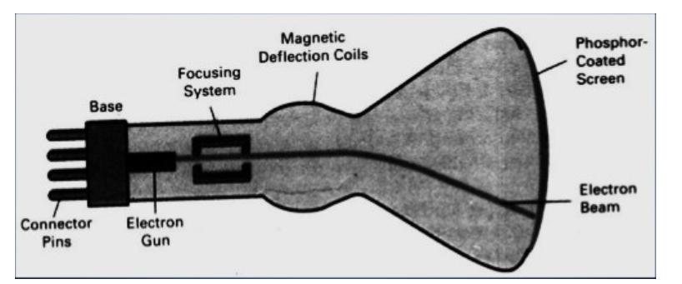

Slide 11
These are the special electronic vacuum tubes that use focused electrons beams to display images.
CRTs are widely used in television, oscilloscope, computer and radar display.
It has a cathode or negatively charge terminal. The filament is contained inside a vacuum with a glass tube. A beam of electrons is allow to flow from filament into the vacuum.
The flow of electrons is natural not forced. CRT electrons are concentrated in a light beam by a positively charged terminal called anode.
An accelerating anode is then used to speed up the movement of electrons. These fast moving electrons hit the phosphor coated screen and makes it glow.
The way to keep the phosphor glowing is to repeatedly directly the electron beam back over the same point is known as refresh CRT.

